Slide 1
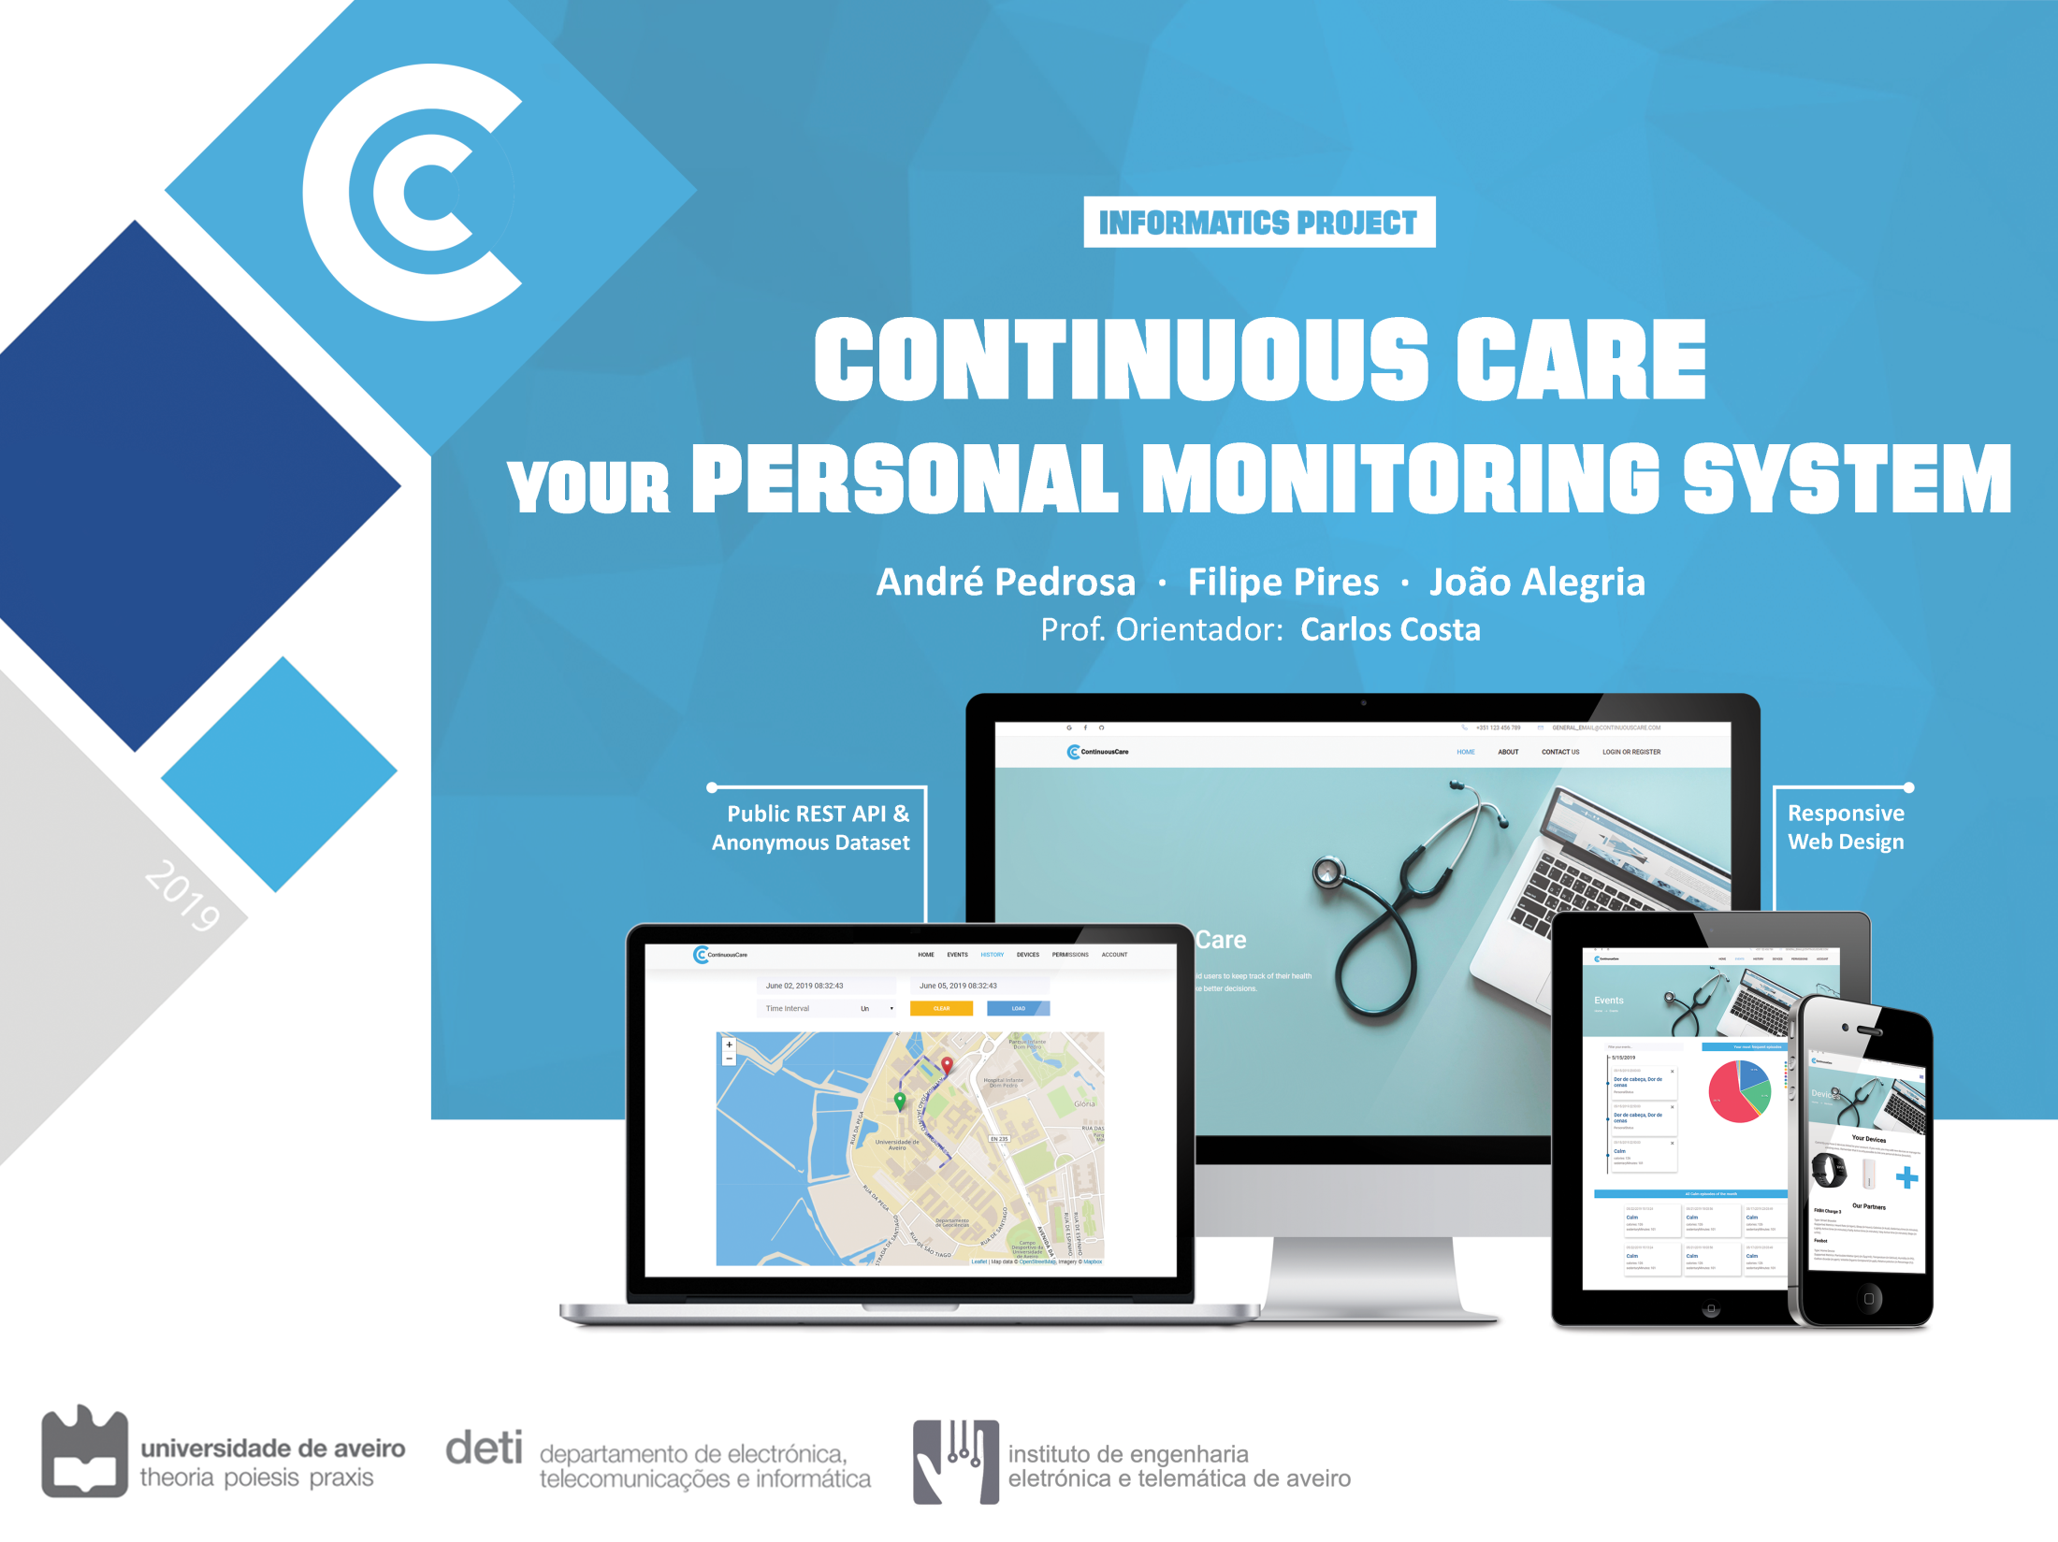

Slide 2

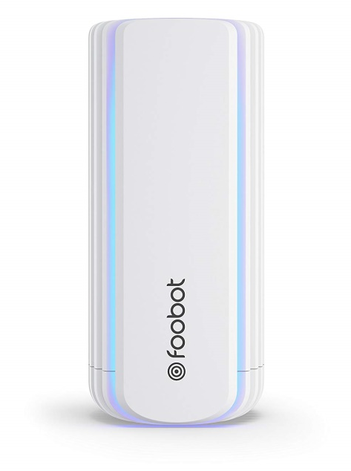
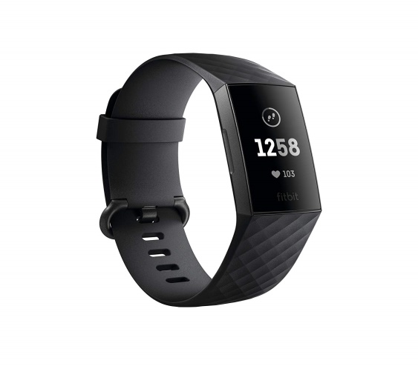

Contextualization
Increased proliferation of mobile devices for monitoring vital signals and physical activity
integration of smart devices with air quality monitors
Use of geolocation to keep track of the environment the patient was exposed to
Need for quality labelled quotidian data in the medical field
→ A new paradigm of medical monitorization

Slide 3
State-of-the-art
Health Monitoring Systems using IoT and RaspberrPi
Angel-Echo
Geolocation Based Health Monitoring and Alarm System
Beyond Health Tracking
Ubiquitous Personal Health Surveillance and Management

Slide 4
Project Goals
Development Objectives:
Transparent & Continuous Data Collection
Simplistic and Professional Design
Intuitive Data Visualization Tools
Doctor-Patient Interaction
ContinuousCare is all about:
helping citizens better understand their health and body activity
aiding professional doctors with analysis tools
making available valuable data for external systems

Slide 5

Design decisions
Modular Architecture
Geolocation Tracking
Hybrid Storage
Data Aggregation

Slide 6
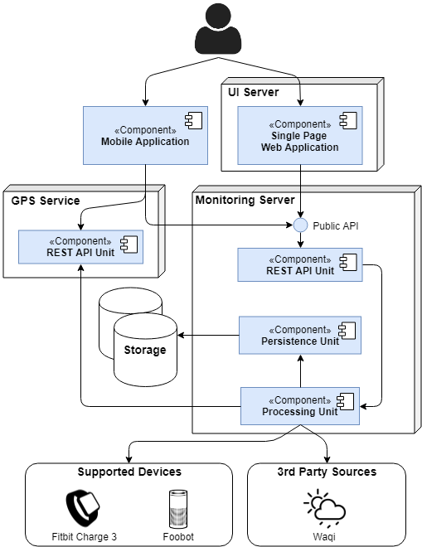
Architecture

Slide 7
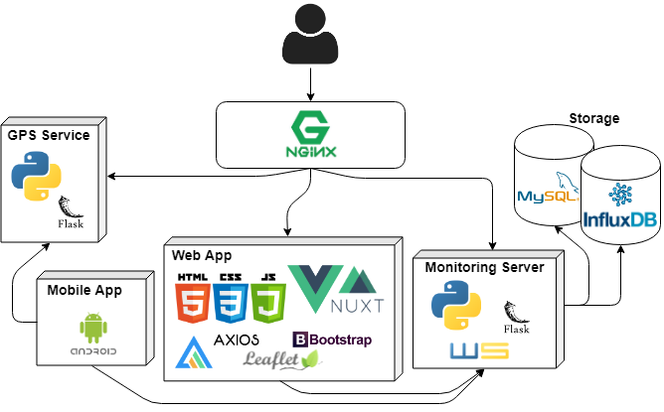
Technologies

Slide 8
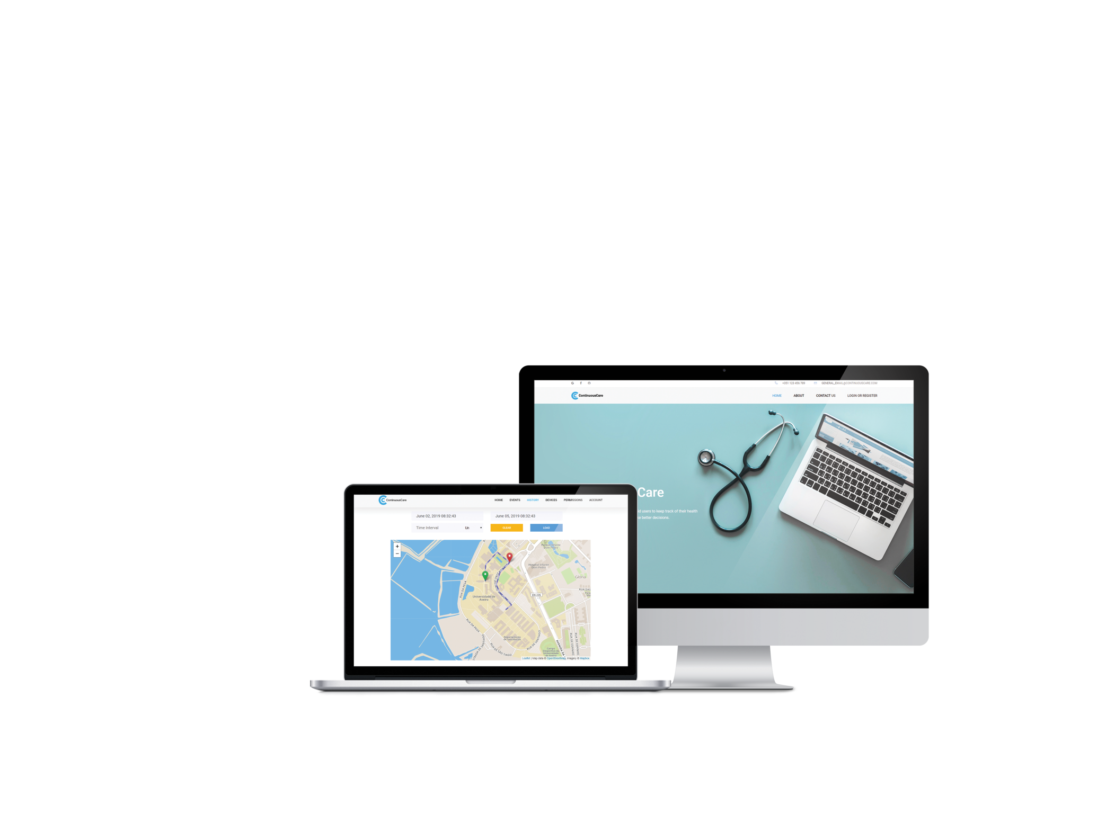
Final Product
Modern Supported Devices
Web and Mobile Applications
Public REST API w/ Documentation

Slide 9
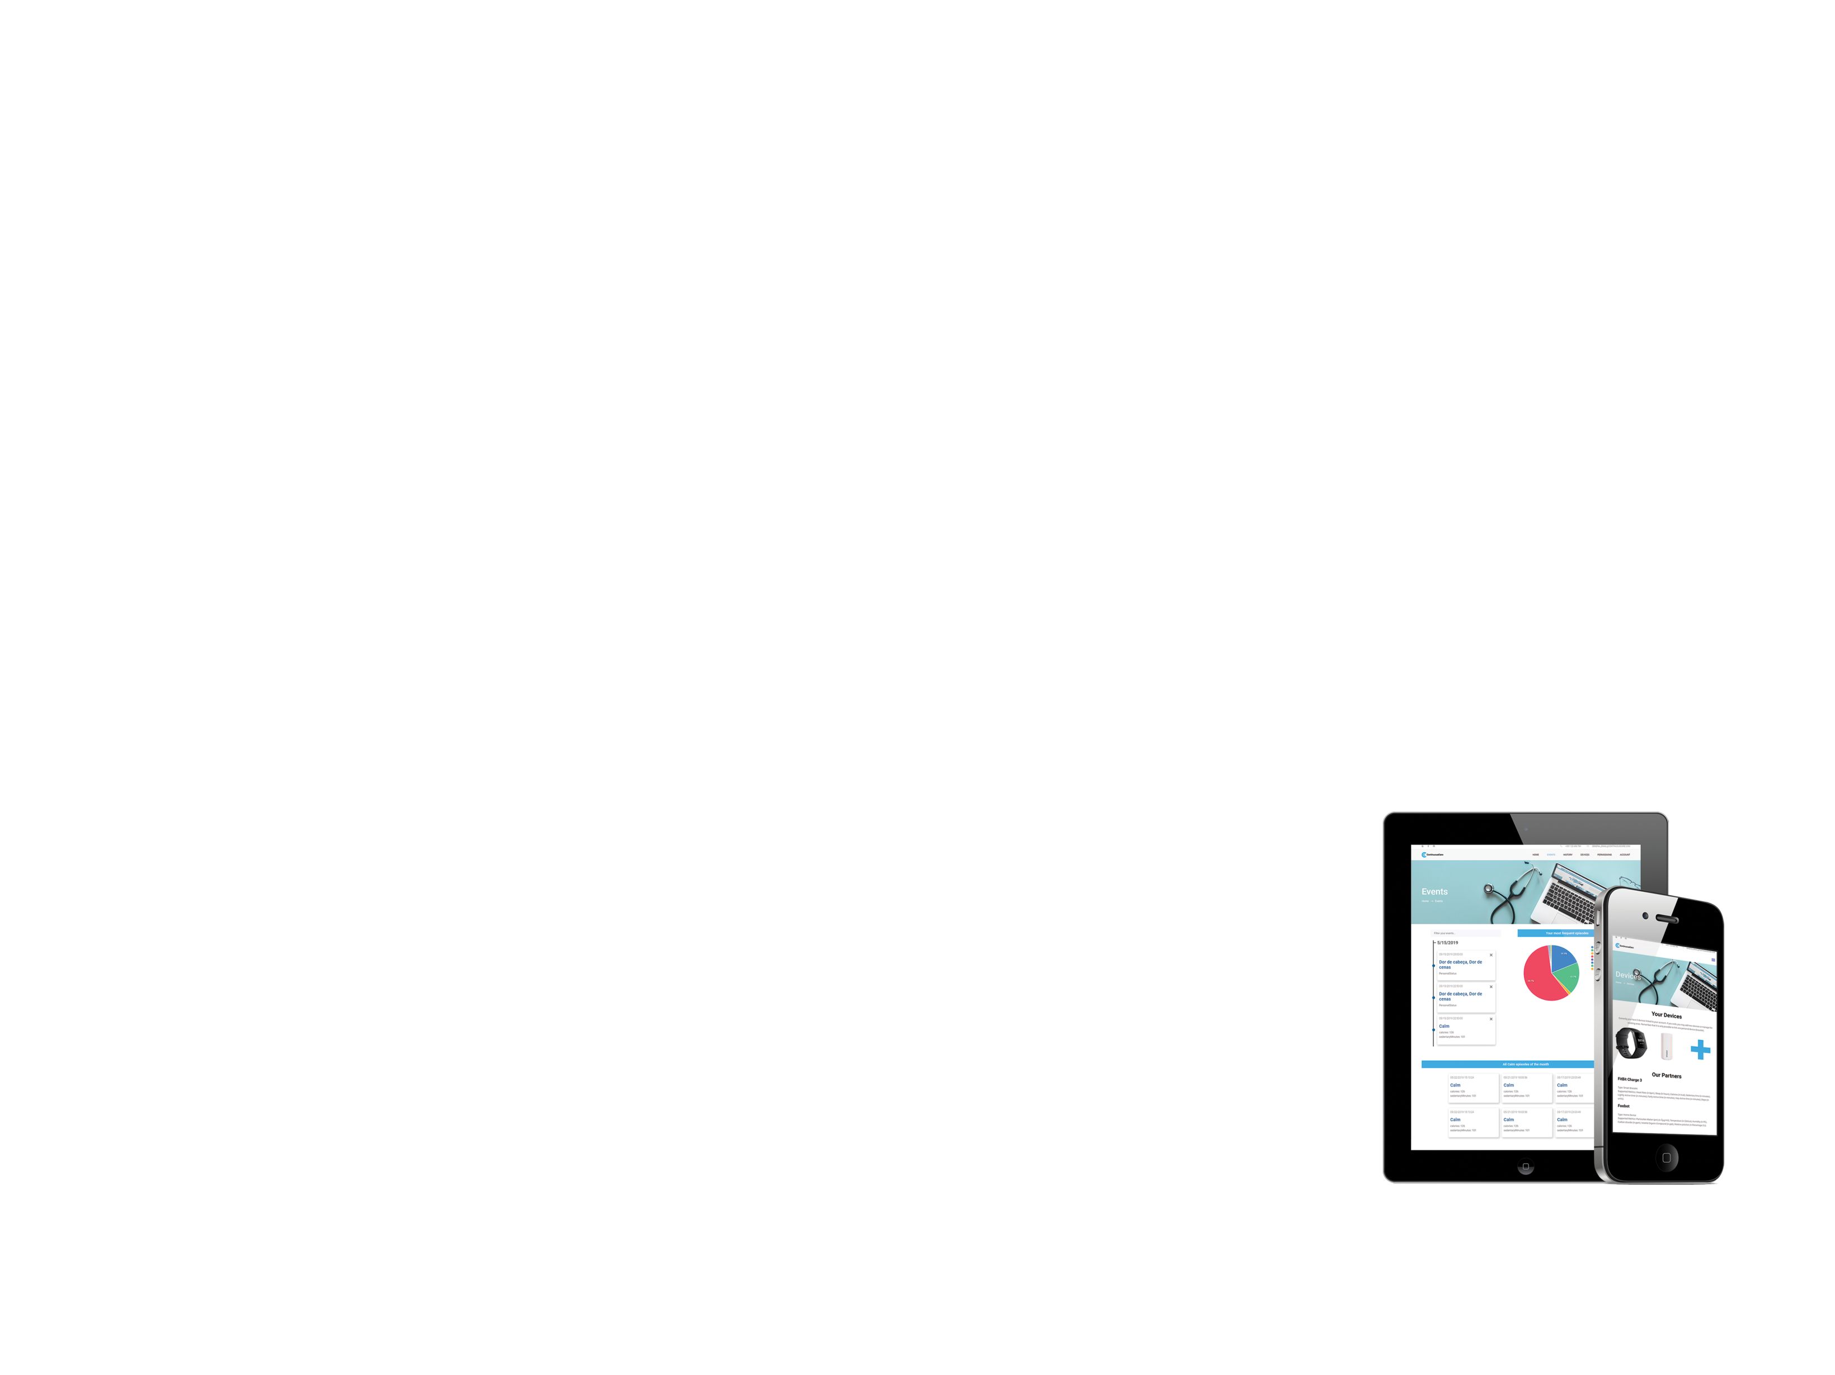
Outcome
Modular Device Support
Data Export Available
Scalability Ensured
Performance Tested

Slide 10

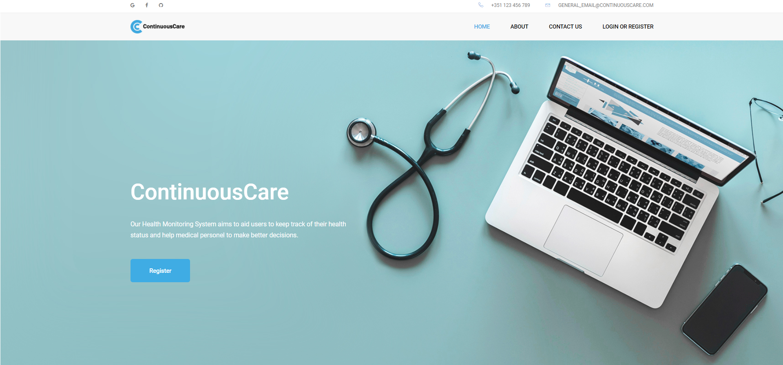
Demonstration

Slide 11
Conclusions
As intended, ContinuousCare promises to aid any user interested in perfecting their lifestyle and monitoring the surroundings.
It now has the potential to develop into a more intelligent and specific system capable of detecting dangerous behaviours and hazardous environments.

Slide 12
